Slide 1
BTC 01
Microbial Growth Curve

Slide 2
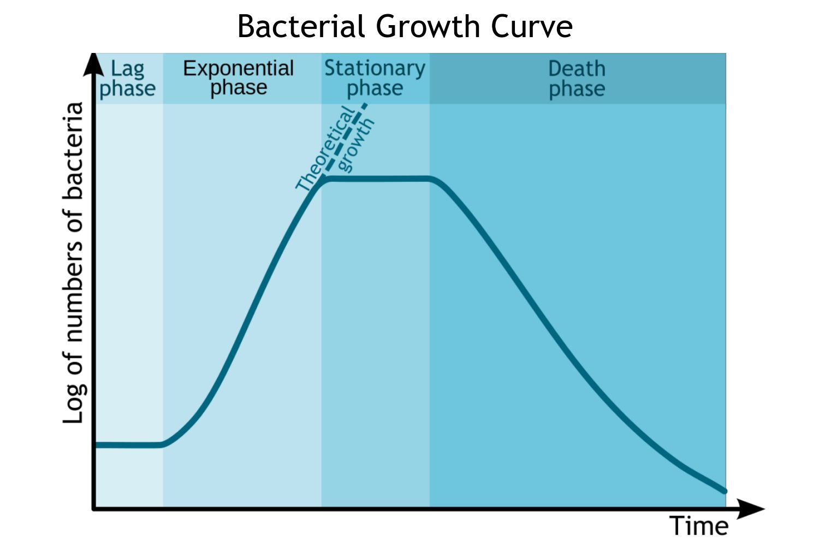

Slide 3
Normal growth cycle of Bacteria/Phases of Microbial growth
Lag Phase
1. Individual cell increases in size beyond their normal dimension
2. Physiologically they are very active and synthesize new Protoplasm
3. New Enzyme and co enzyme are synthesized
Logarithmic Phase/Exponential Phase
1. Cells divide at a constant rate
2. Population is nearly uniform in terms of chemical composition of cells, Metabolic Activity, Physiological Characteristics.
Stationary Phase
1. Exhaustion of some nutrients
2. Production of toxic products during growth
3. Population remains constant , perhaps as a result of complete cessation of division or perhaps because the reproduction rate is balanced by an equivalent death rate.
Phase of Decline / Death
1. Microorganism may die faster than new cell are produced- some cell still reproduce
2. Depletion of essential nutrients
3. Accumulation of inhibitory products such as acids
4. Number of viable cell decreases exponentially-inverse of growth during log phase

